Slide 1
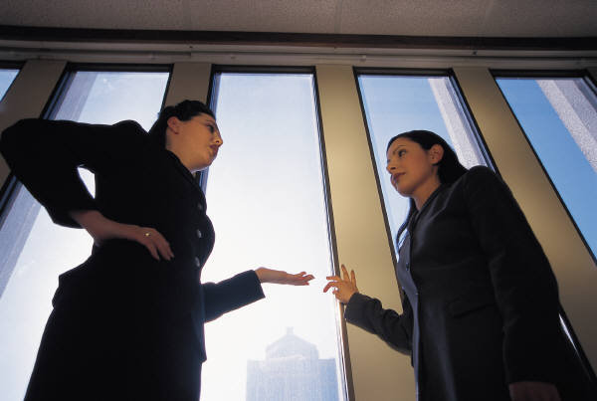
Effective Communication In An Age Of Information Overload
2016 PACHC Conference & Clinical Summit
John Rinehart

Slide 2
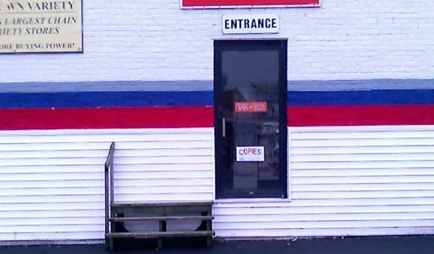
Why?
More often than not, success (and failure) are a direct result of how well the people involved communicate, not how skilled or intelligent they are.

Slide 3
Information VS Communication
1990 – 5.2 million mobile phones
2014 – 327.6 million mobile “phones”
2008 – 1 billion personal computers
2010 – 294 billion emails/day,
90 trillion / year – 90% spam
Web – 13.71 billion pages (Britannica 17,00 pages)
5 exabites of new information every year
5 exabites = 37,000 Libraries of Congress
Doubles every 2-3 years!

Slide 4
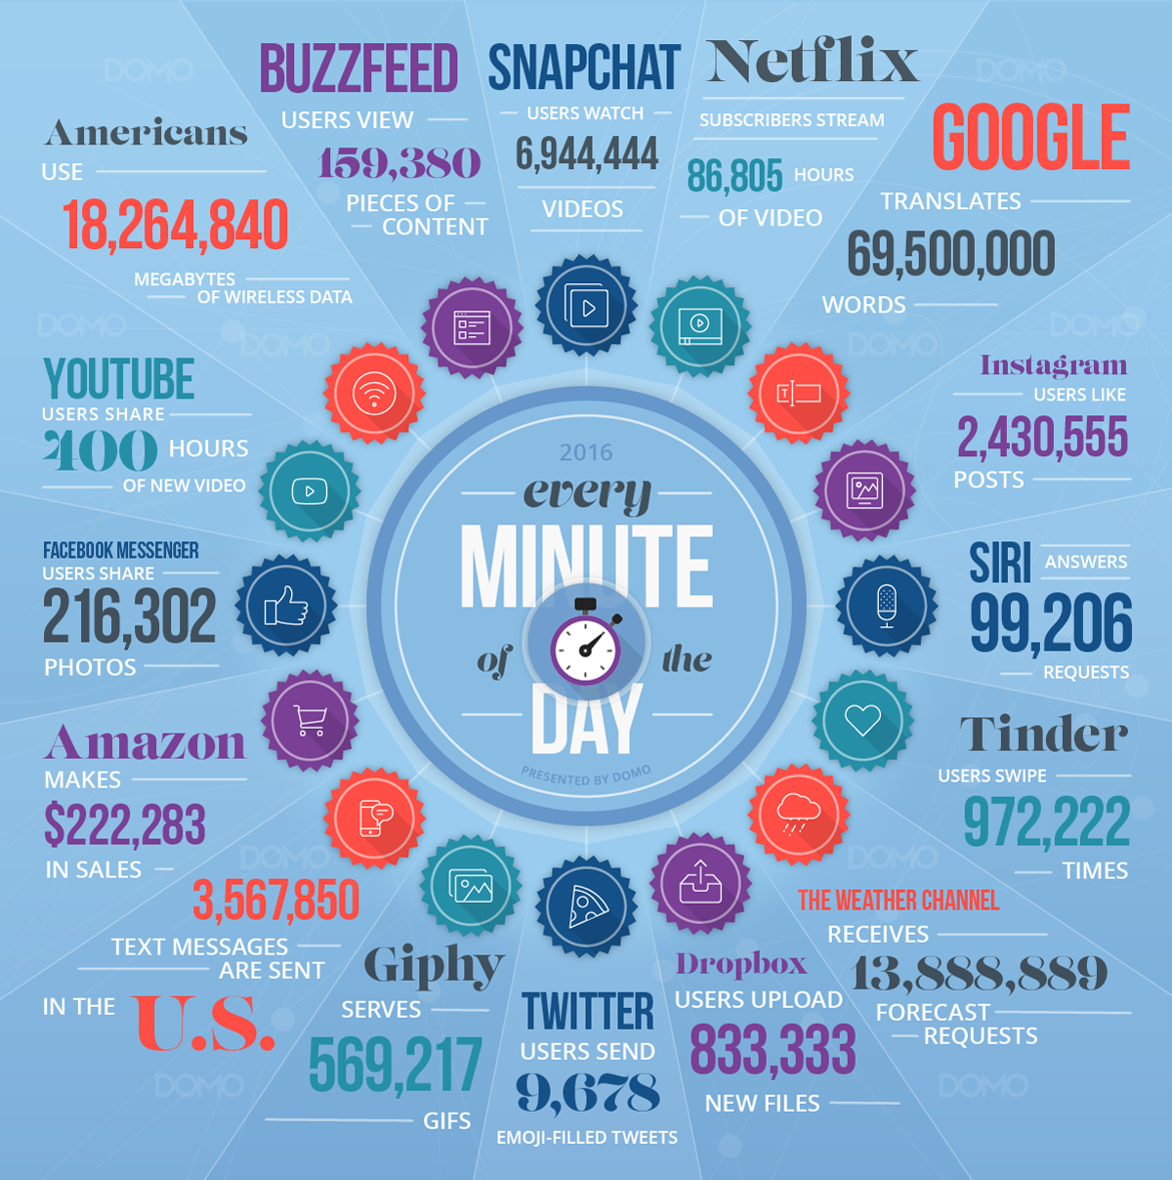

Slide 5

What is effective communication?
?

Slide 6
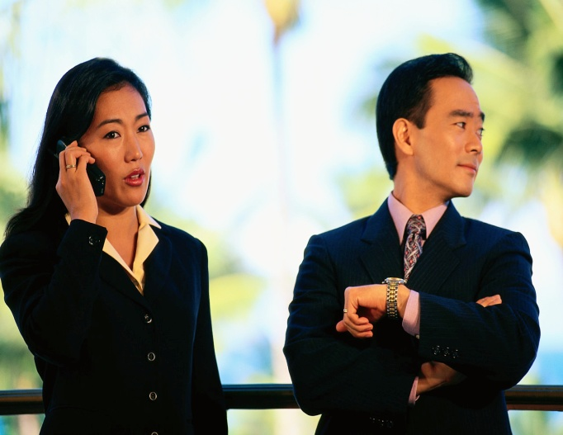
Effective communication?
Clear Message
Well Delivered
Multi-directional as opposed to linear

Slide 7

Clear Message
Understood & Understandable
Is it simple enough to be grasped and complex enough to eliminate ambiguity?
Is it consistent with your other messages and your actions?

Slide 8
Well Delivered
Right Person/People
Right Method
Right Timing
Right Words

Slide 9
The Right Method
In Person, 1-to-1
In Person, Group
Phone
Letter
Memo
Email
Text
Web – SharePoint, Yammer, Etc.
Skype
Twitter

Slide 10

Generational Differences

Slide 11
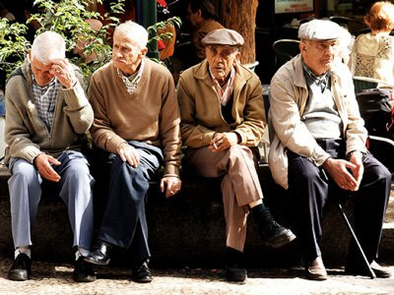
Generational Differences

Slide 12
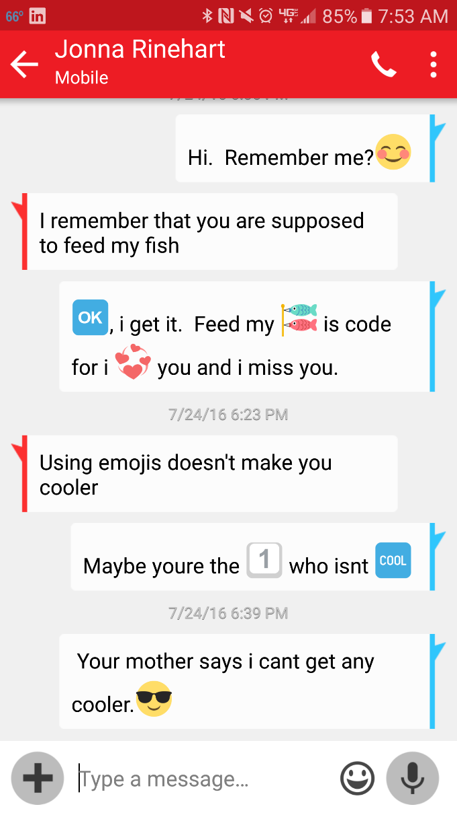
Generational Differences

Slide 13

The Right Words
“Talk Nerdy To Me”

Slide 14

The Right Words – Communication Styles
A – Action
PR – Process
PE – People
I - Idea

Slide 15
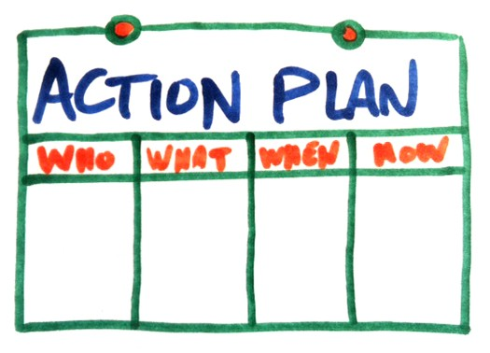
A - Action
Focus on Results
Limit Alternatives
Be Brief
Emphasize Practicality
Use Visuals

Slide 16
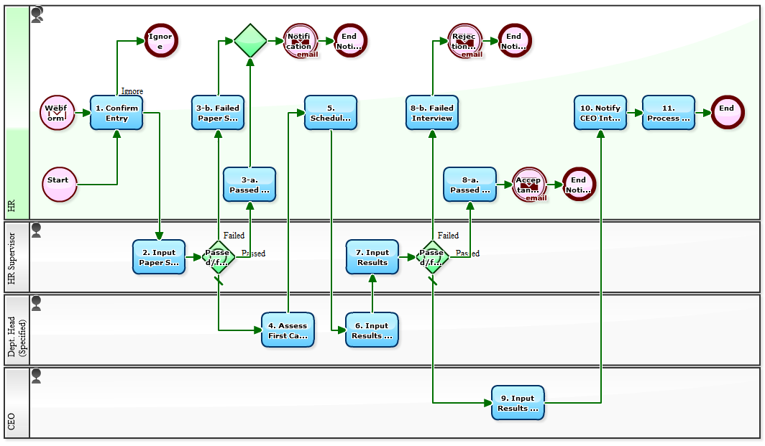
PR - Process
Be Precise and Logical
Background
Outcome
Don’t Rush!

Slide 17

I- Ideas
Time for Discussion
Broader Concept
Uniqueness
Future

Slide 18

PE - People
Small Talk
Stress Relationships
Respected Support
Informal

Slide 19

Communication is Multi-Directional

